Slide 1

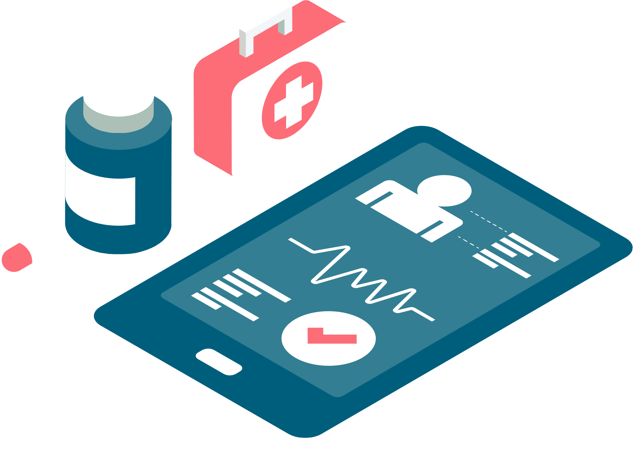


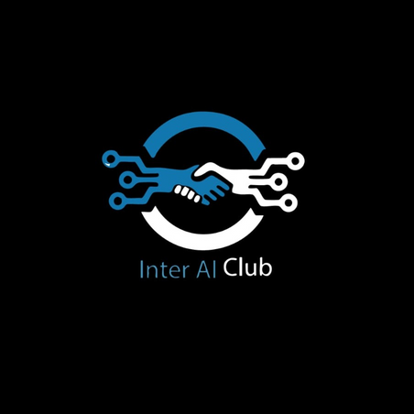

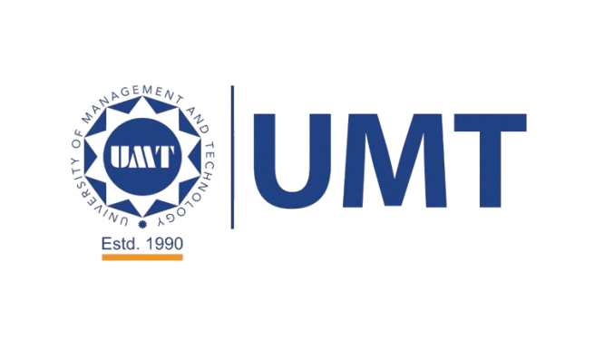

AI HACKATHON
Organized by UMT, TechVerse in collab with Inter-AI Club

Slide 2

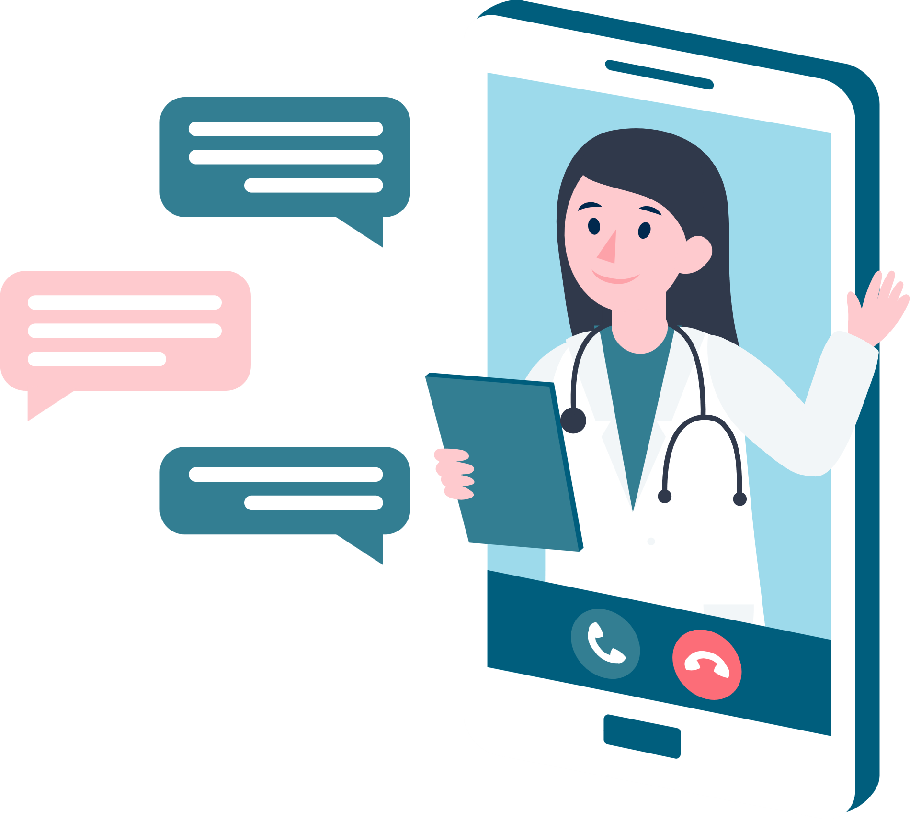


MOTIVATION
When my mother became ill, I received her medical lab reports but couldn't understand their complex terms and numbers. I felt helpless, anxiously searching online and worrying about her health, unsure of what the results meant. Thankfully, she recovered, but that frightening experience made me realize how critical it is for people to quickly and easily understand their medical results. I envisioned a solution: an instant, simple explanation of lab reports, spoken clearly in Urdu. This inspired me to create Sehat Guftagu, so no family has to face uncertainty and fear alone again.

Slide 3
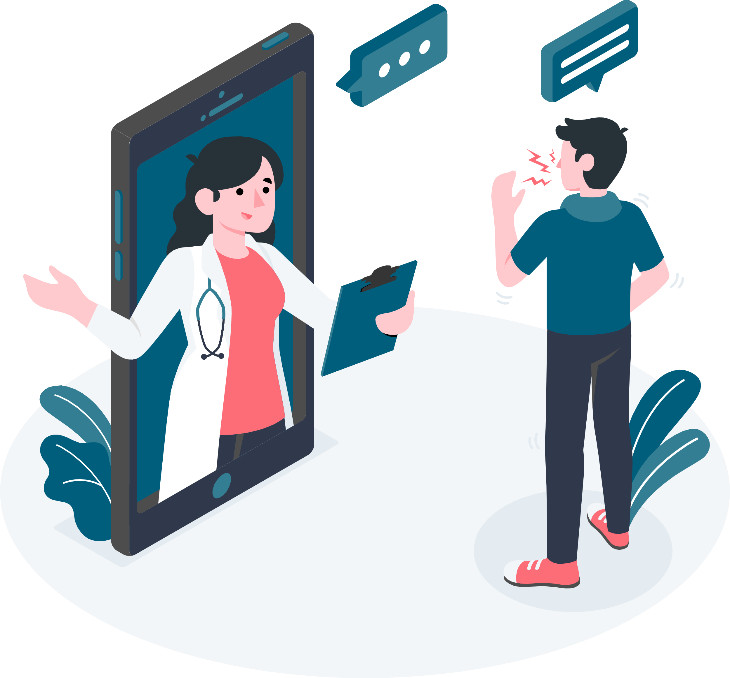




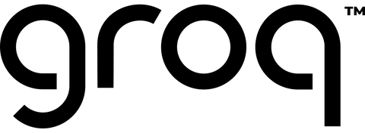
صحت گفتگو
SEHAT GUFTAGU
A doctor who analyzes medical report and guides the patient
ѕтяαηgєrs
Demo Day 2025

Slide 4




PROBLEM STATEMENT
Unreadable Lab Reports
Risky Self-Diagnosis
Patients get complex PDFs (CBC, LFT, RFT, Lipid Profile) that they can’t interpret, especially in rural or low-literacy areas, causing anxiety and confusion.
Without clear guidance, people Google individual numbers or follow incomplete advice, leading to misdiagnosis or delayed care.
Language & Accessibility Gaps
Limited Doctor Access
Long waits for a specialist’s review in big hospitals, and no pathologist is available in remote clinics.
English medical jargon and text-only reports exclude many, as there is no Urdu-audio option for those who are elderly, visually impaired, or non-English speakers

Slide 5
SOLUTION WE PROVIDE
Instant AI Analysis
Doctor‐Style Urdu Guidance
Users upload a lab‐report PDF; Groq‐powered AI instantly interprets values and displays a clear English summary.
The AI crafts a conversational advice script, translates it into colloquial Urdu, and generates an MP3 via UpliftAI. Just press “Play.”
On-Demand Access
Easy, Mobile-Friendly UI
No more waiting days for a doctor’s review; reports are analyzed and spoken back within seconds, whether you’re in a big city or a remote village.
A browser-based Streamlit app runs on any smartphone or tablet no downloads or installations required.

Slide 6

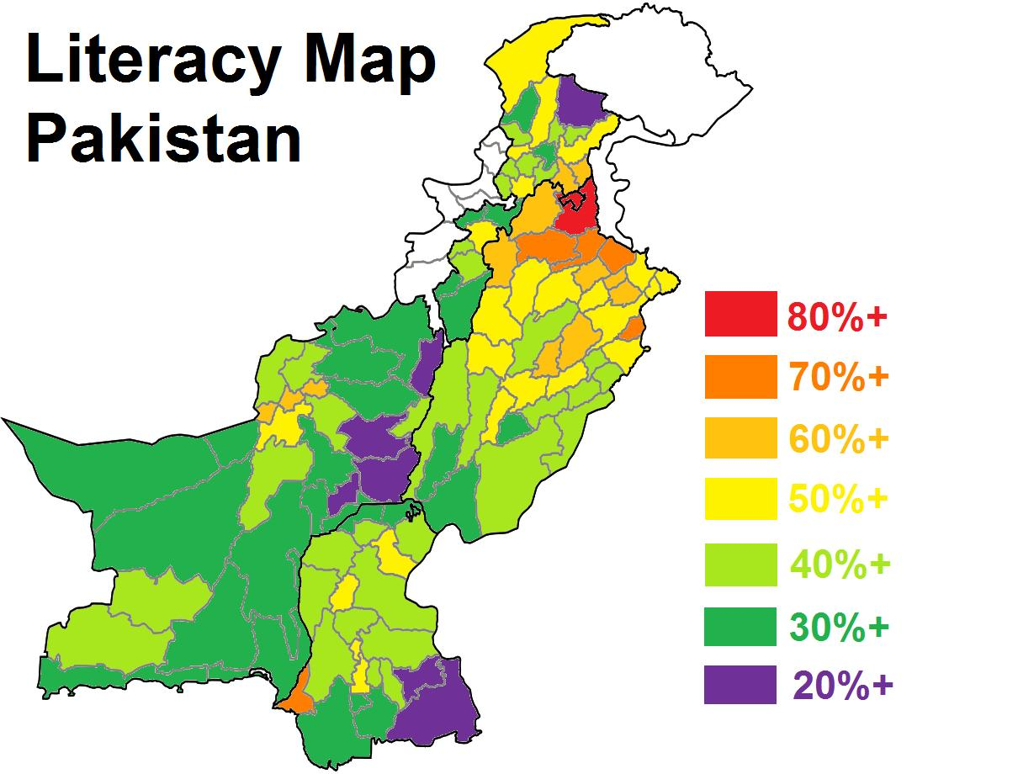
According to the 2023 census, Pakistan's overall literacy rate is 60.6%, with males having a higher literacy rate at 68% compared to females at 52.8%. This means that approximately 60 million people in Pakistan are illiterate

Slide 7
WOW FEATURE (FUTURE PLANS)
1️⃣ Doctor Recommendations by Condition
2️⃣ City-Based Hospital Suggestions
3️⃣ Available & Low-Budget Doctors
4️⃣ Out-of-City Doctor Consent
5️⃣ Estimated Budget Overview
🌐 Multilingual Support
📱 WhatsApp Integration
🧑‍⚕️ Live Doctor Chat
🔒 Medical History Tracker
AND MUCH MORE...

Slide 8



PRODUCT DEMO

Slide 9





THANKS

